Slide 1
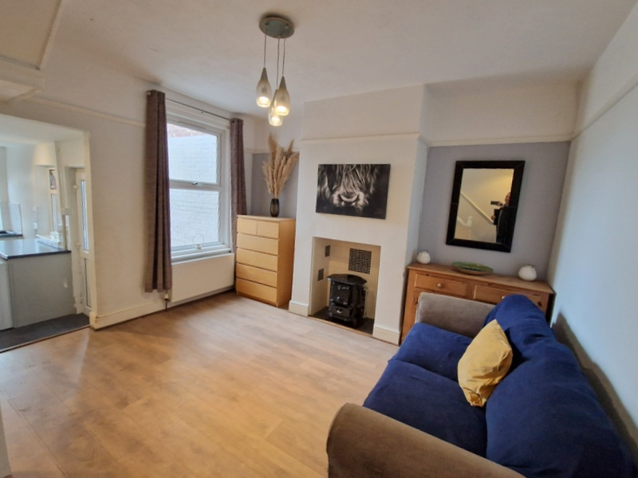
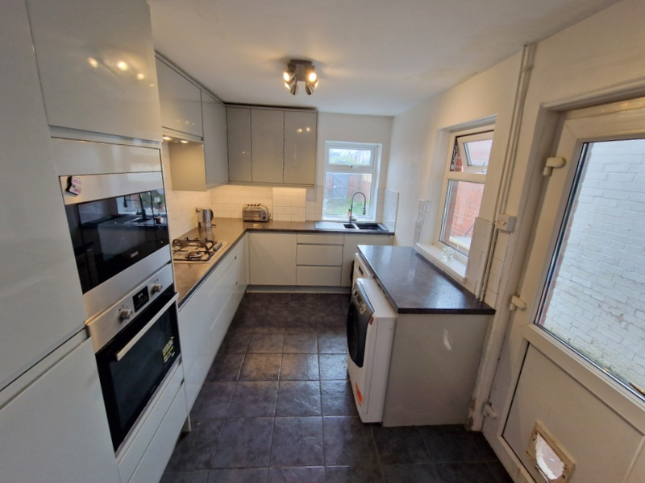
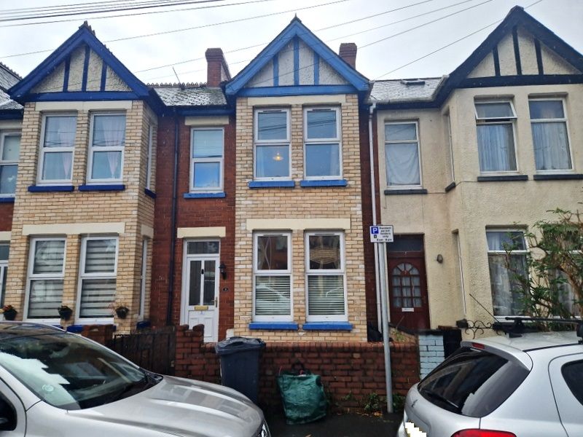
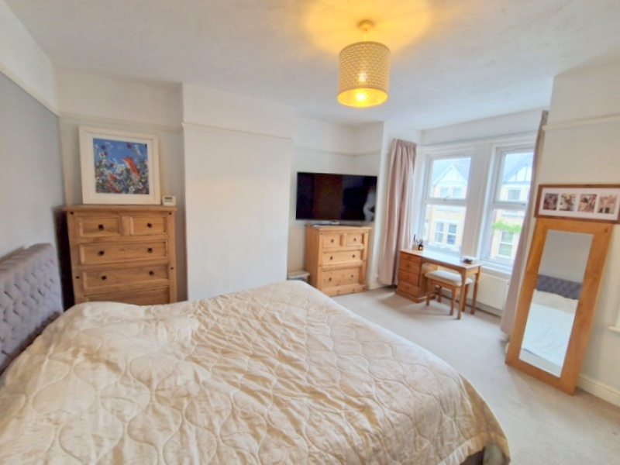
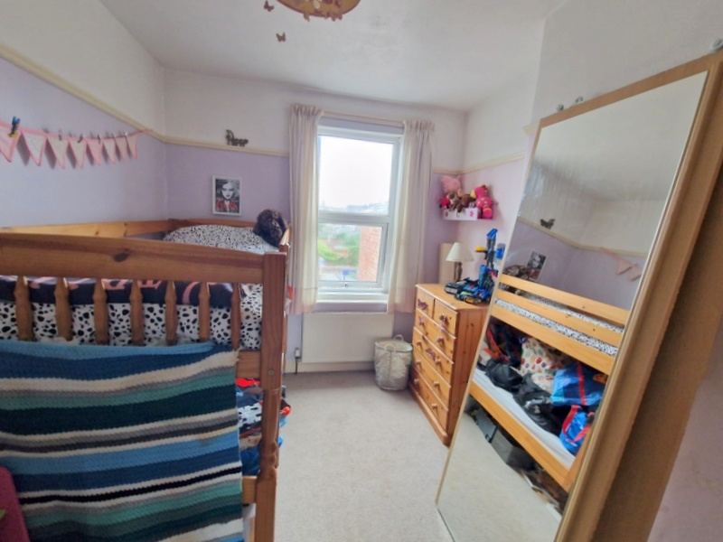
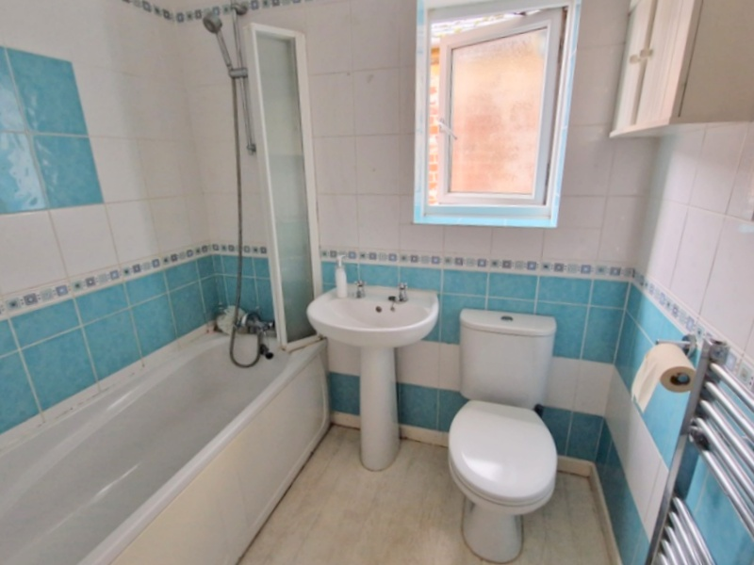
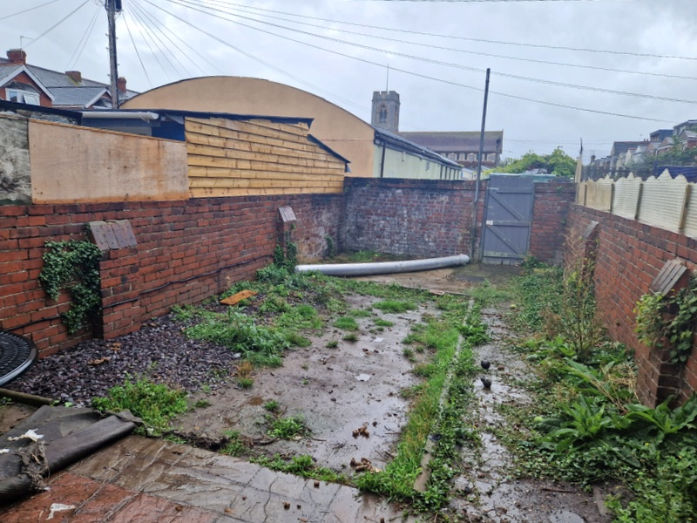
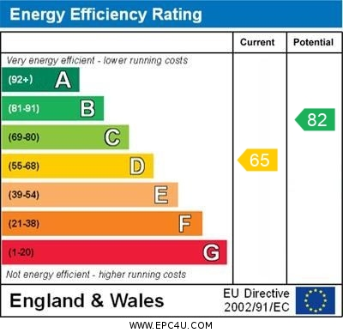
www.pennys.net
5 Hartopp Road, Exmouth, EX8 1SB
GUIDE PRICE £325,000
TENURE Freehold
A Substantial Square Bay Fronted Period Terrace House Ideally Located Only A Short Distance From Amenities, Town Centre And Train Station
Entrance Vestibule * Reception Hall * Square Bay Lounge * Dining/Family Room * Modern Stylish Kitchen * Three First Floor Bedrooms * Bathroom/Wc Gas Central Heating * Upvc Double Glazing * Enclosed Rear Garden
Pennys Estate Agents Limited for themselves and for the vendor of this property whose agents they are give notice that:- (1) These particulars do not constitute any part of an offer or a contract. (2) All statements contained in these particulars are made without responsibility on the part of Pennys Estate Agents Limited. (3) None of the statements contained in these particulars are to be relied upon as a statement or representation of fact. (4) Any intending purchaser must satisfy himself/herself by inspection or otherwise as to the correctness of each of the statements contained in these particulars. (5) The vendor does not make or give and neither do Pennys Estate Agents Limited nor any person in their employment has any authority to make or give any representation or warranty whatever in relation to this property.
PENNYS ESTATE AGENTS
2 Rolle House, Rolle Street, Exmouth, Devon, EX8 2SN
Tel: 01395 264111 EMail: help@pennys.net

Slide 2
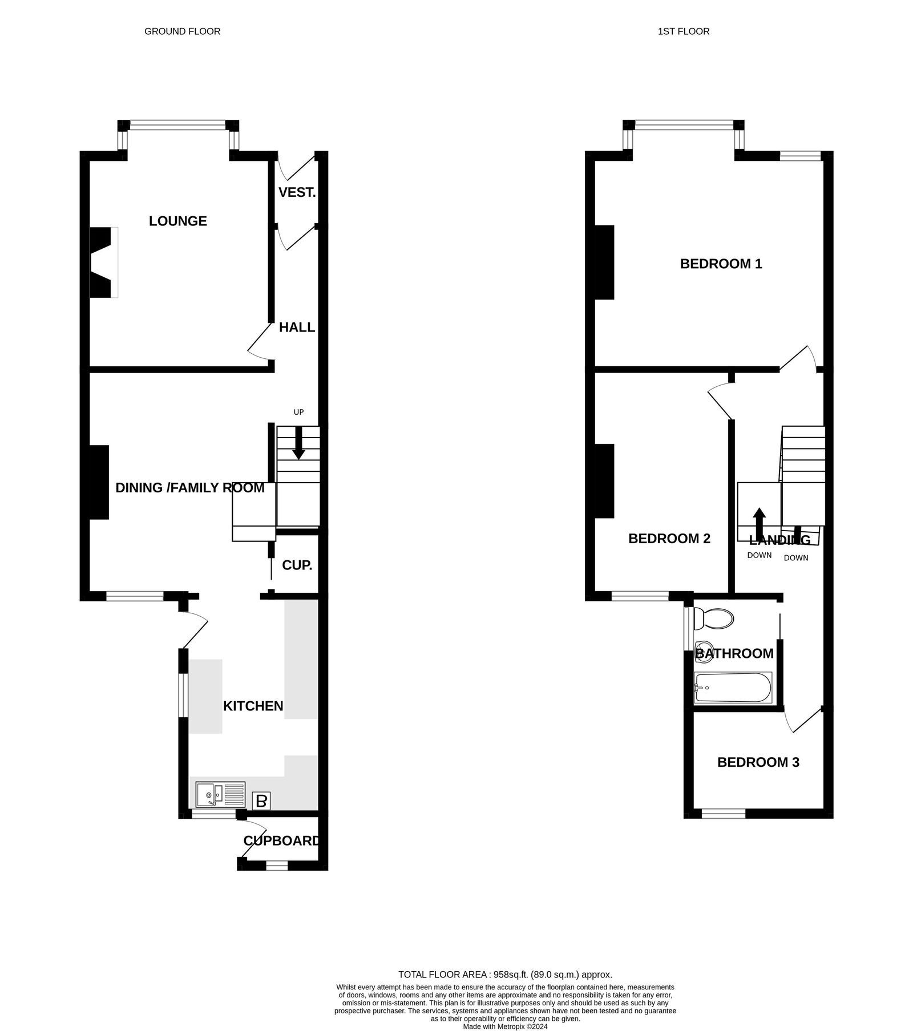
5 Hartopp Road, Exmouth, EX8 1SB
THE ACCOMMODATION COMRPRISES: uPVC double glazed front door with patterned window inset to:
ENTRANCE VESTIBULE: Inner solid wood part glazed door to:
RECEPTION HALL: With wood laminate flooring, radiator, staircase rising to first floor and opening through to dining/family room:
LOUNGE: 4.83m x 3.3m (15'10" x 10'10") maximum measurement into wall recesses. uPVC double glazed square bay window overlooking the front elevation, attractive wood fire surround with tiled hearth and inset housing living flame coal effect gas fire, picture rail wood laminate flooring, radiator.
DINING/FAMILY ROOM: 4.39m x 4.01m (14'5" x 13'2") including stairwell recess. A charming room with chimney recess with tiled inset and hearth housing cast iron feature stove, radiator, wood laminate flooring uPVC double glazing window to rear aspect, understairs recess with coat rack and light, large opening to:
KITCHEN: 3.86m x 2.44m (12'8" x 8'0") Stylish modern kitchen with range of patterned worktops with inset one and a half bowl single drainer sink unit with hose style mixer tap in tiled surrounds, with range of cupboards and drawer units, plumbing for automatic washing machine and dishwasher space beneath worktops, built-in oven and microwave with drawer units below and cupboard over, integrated fridge and freezer, inset four-ring gas hob with filter extractor hood over with light, wall mounted cupboards with concealed lighting beneath, two sets of double glazed windows overlooking the side and rear aspects, double glazed door giving access to the rear garden, tiled flooring, ceiling spotlighting.
FIRST FLOOR SPLIT LEVEL LANDING: Picture window and small access to roof space.
BEDROOM 1: 4.72m x 4.04m (15'6" x 13'3") maximum measurement into wall recesses. uPVC double glazed square bay window overlooking the front elevation, with additional double glazed window to front aspect, picture rail, radiator, TV point.
BEDROOM 2: 4.06m x 2.62m (13'4" x 8'7") uPVC double glazed window to rear aspect, radiator, picture rail. TV point.
BEDROOM 3: 2.49m x 1.78m (8'2" x 5'10") With uPVC double glazed window to rear aspect, radiator, picture rail.
BATHROOM/WC: Comprising bath with shower attachment, shower splash screen, pedestal wash hand basin, WC with push button flush, chrome heated towel rail, extensively tiled walls, medicine cabinet, fitted wall mirror, access to loft space, uPVC double glazed window with patterned glass.
OUTSIDE: To the side of the property is a small garden enclosure, to the rear is an enclosed garden with rear pedestrian gate, outside store with plumbing for automatic washing machine, outside cold water tap.
Mortgage Assistance: We are pleased to recommend Meredith Morgan Taylor, who would be pleased to help no matter which estate agent you finally buy through. For a free initial chat please contact us on to arrange an appointment. Your home may be repossessed if you do not keep up repayments on your mortgage. Meredith Morgan Taylor Ltd is an appointed representative of The Openwork Partnership, a trading style of Openwork Ltd which is authorised and regulated by the Financial Conduct Authority (FCA).
FLOOR PLAN:

